Slide 1
Introduction: Databases and Database Systems

Slide 2
What is DataBase ?
An organized collection of related data.
Example of Database
a telephone book
T.V. Guide
papers in your filing cabinet
files on your computer hard drive
Notes:
Data:
Facts that can be recorded and have an implicit meaning.
Data vs Information :
unprocessed information vs Information is data that have been organized and communicated in a coherent and meaningful manner.

Slide 3
Database System
Database Management System (DBMS):
A software system to facilitate the creation and maintenance of a computerized database.
Database System:
A collection of interrelated data and a set of programs to access those data
It includes DBMS and the data.
Sometimes, the applications are also included.

Slide 4
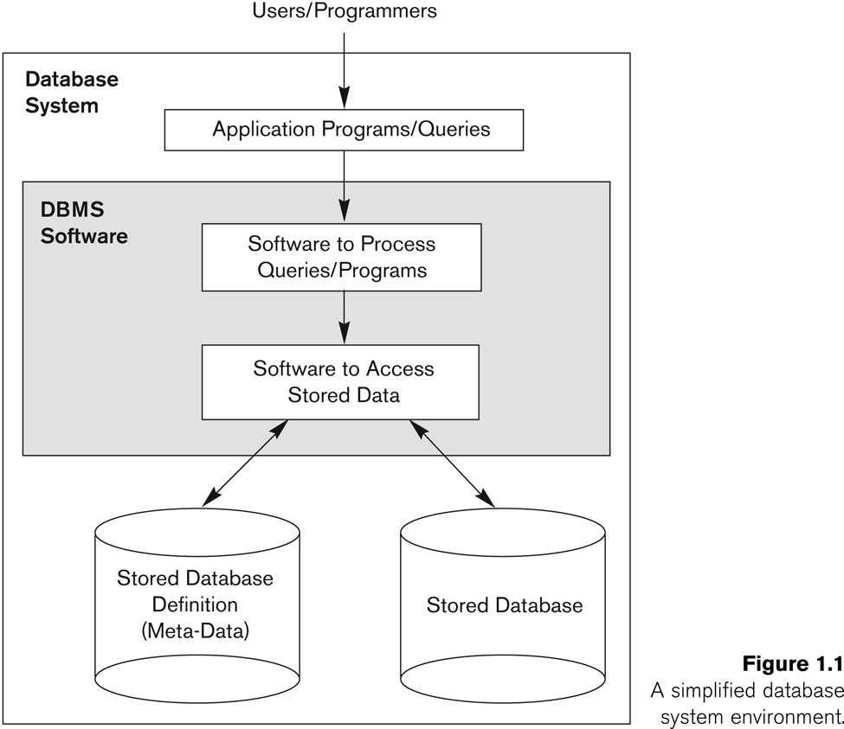
Simplified database system environment

Slide 5
Database System Applications
Some representative applications
Banking
Airlines
Universities
Hospitals
Telecommunication
Sales
Manufacturing
Human Resources
Notes:
Banking: For customer information, accounts, and loans, and banking transactions.
• Airlines: For reservations and schedule information. Airlines were among the
first to use databases in a geographically distributed manner—terminals situated
around the world accessed the central database system through phone
lines and other data networks.
• Universities: For student information, course registrations, and grades.
Credit card transactions: For purchases on credit cards and generation of monthly
statements.
• Telecommunication: For keeping records of calls made, generating monthly bills,
maintaining balances on prepaid calling cards, and storing information about
the communication networks.
• Sales: For customer, product, and purchase information.
• Manufacturing: For management of supply chain and for tracking production
of items in factories, inventories of items in warehouses/stores, and orders for
items.
• Human resources: For information about employees, salaries, payroll taxes and
benefits, and for generation of paychecks.

Slide 6
Drawbacks of file system
Data redundancy and inconsistency
Multiple file formats, duplication of information in different files
Difficulty in accessing data
Need to write a new program to carry out each new task
Data isolation — multiple files and formats
Integrity problems
Integrity constraints (e.g. account balance > 0) become part of program code
Hard to add new constraints or change existing ones
Notes:
Data isolation. Because data are scattered in various files, and files may be in
different formats, writing new application programs to retrieve the appropriate
data is difficult.

Slide 7
Drawbacks of file system
Atomicity of updates
Failures may leave database in an inconsistent state with partial updates carried out
E.g. transfer of funds from one account to another should either complete or not happen at all
Concurrent access by multiple users
Concurrent accessed needed for performance
Uncontrolled concurrent accesses can lead to inconsistencies
E.g. two people reading a balance and updating it at the same time
Security problems
Database systems offer solutions to all the above problems

Slide 8
Example of a Database
Mini-world: UNIVERSITY
Some mini-world entities:
Students
Courses
Section (of Courses)
Departments
Instructors
Some mini-world relationships:
Sections are of specific Courses
Students take Sections
Courses have prerequisite Courses
Instructors teach Sections
Courses are offered by Departments
Notes:
Mini-world:
Some part of the real world about which data is stored in a database. For example, University.

Slide 9
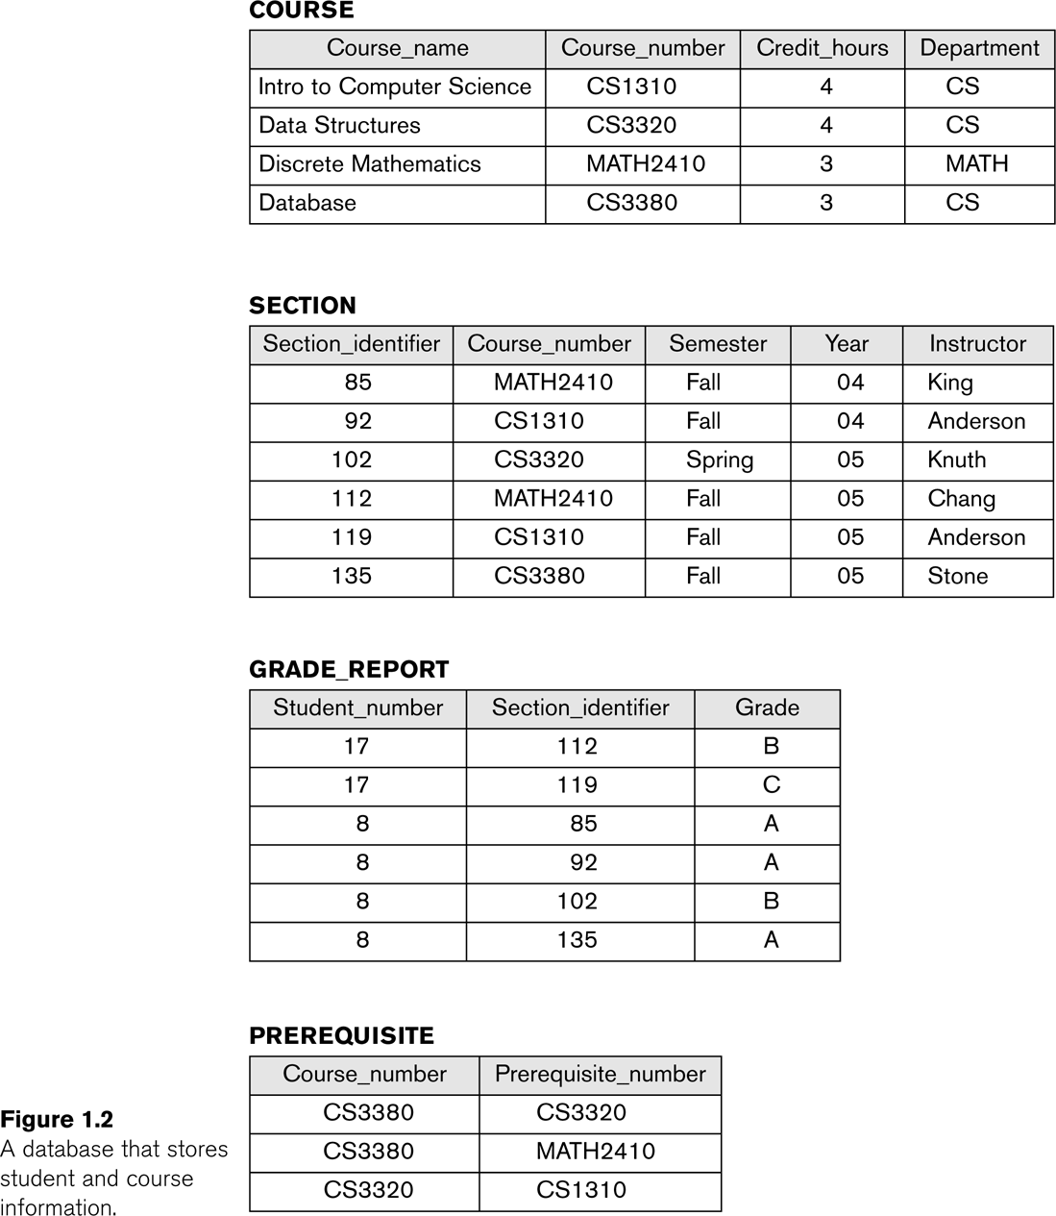
Example of a simple database

Slide 10
Characteristics of the Database Approach
Self-describing nature of a database system:
Meta-data, the description of DB, is stored in DBMS catalog (e.g. data structures, types, and constraints)
This allows the DBMS software to work with different database applications.
Notes:
Drawbacks of using file systems to store data:
Data redundancy and inconsistency
Multiple file formats, duplication of information in different files
Difficulty in accessing data
Need to write a new program to carry out each new task
Data isolation — multiple files and formats
Integrity problems
Integrity constraints (e.g. account balance > 0) become part of program code
Hard to add new constraints or change existing ones
Atomicity of updates
Failures may leave database in an inconsistent state with partial updates carried out
E.g. transfer of funds from one account to another should either complete or not happen at all
Concurrent access by multiple users
Concurrent accessed needed for performance
Uncontrolled concurrent accesses can lead to inconsistencies
E.g. two people reading a balance and updating it at the same time
Security problems
Database systems offer solutions to all the above problems

Slide 11
Characteristics of the Database Approach
Program-data independence:
Can change data structures and storage organization without changing the DBMS access programs.
Notes:
Drawbacks of using file systems to store data:
Data redundancy and inconsistency
Multiple file formats, duplication of information in different files
Difficulty in accessing data
Need to write a new program to carry out each new task
Data isolation — multiple files and formats
Integrity problems
Integrity constraints (e.g. account balance > 0) become part of program code
Hard to add new constraints or change existing ones
Atomicity of updates
Failures may leave database in an inconsistent state with partial updates carried out
E.g. transfer of funds from one account to another should either complete or not happen at all
Concurrent access by multiple users
Concurrent accessed needed for performance
Uncontrolled concurrent accesses can lead to inconsistencies
E.g. two people reading a balance and updating it at the same time
Security problems
Database systems offer solutions to all the above problems

Slide 12
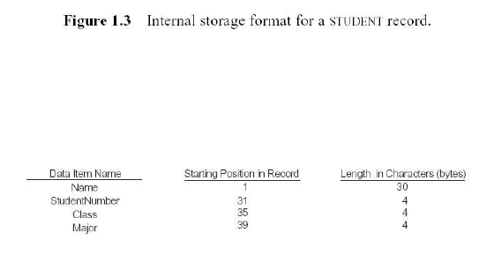
Characteristics of the Database Approach
Data Abstraction:
Data model is used to hide storage details and present the users with a conceptual view of the database.
Programs refer to the data model constructs rather than data storage details

Slide 13
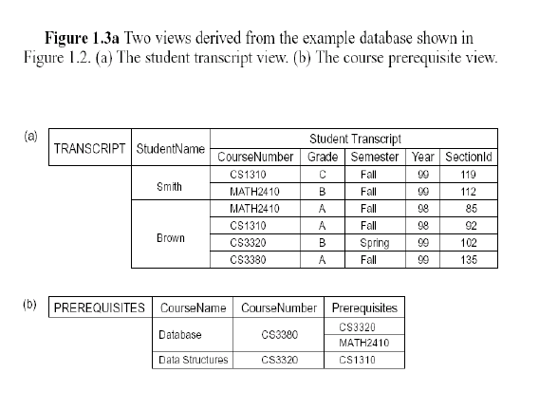
Support multiple views of the data:
Each user may see a different view of the database, which describes only the data of interest to that user.

Slide 14
Database Users
Database administrators:
Responsible for authorizing access, coordinating and monitoring its use, acquiring software and hardware resources, and monitoring efficiency of operations.
Database Designers:
Responsible to define the content, the structure, the constraints, and transactions against the database.
End-users:
They use the data for queries, reports and some of them update the database content.

Slide 15
Advantages of DBMS
Control redundancy
Data Sharing
Restrict unauthorized access
Provide Storage Structures (e.g. indexes for efficient Query Processing)
Backup and recovery services
Multiple interfaces for different classes of users
Enforce integrity constraints on the database

Slide 16
situations where DB System is not desirable
Simple, well-defined database that are not expected to change at all
Stringent, real-time requirements that may not be met because of DBMS overhead
Embedded systems with limited storage capacity,
No multiple-user access to data
Notes:
infact it is better to use regular files under the following circumstances:
Embedded systems with limited storage capacity, where a general-purpose DBMS would not fit

Slide 17
Database System Concepts and Architecture

Slide 18
DESCRIBING AND STORING DATA IN A DBMS
Data Models
A set of concepts to describe the structure of a database and achieve data abstraction.
structure includes data types, relationships and constraints.
Data Model Operations
Basic operations (insert, delete, modify and retrieve)
User-defined operations (compute GPA)
Notes:
One imp characteristic of the database approach is that it provides some level of data abstraction.
Data abstraction generally refers to the suppression of details of data organization and storage, and the highlighting of the essential features
for an improved understanding of data.
One of the main characteristics of the database approach is to support data abstraction so that different users can perceive
data at their preferred level of detail.
A data model is a collection of high-level data description constructs that hide many low-level storage details.
User defined operations are used to specify the dynamic aspect or behavior of a database application.

Slide 19
Categories of Data Models
Conceptual (high-level, semantic) data models
Provide concepts that are close to the way many users perceive data. Also called entity-based or object-based data models.
Physical (low-level, internal) data models
Provide concepts that describe details of how data is stored in the computer.
Implementation (representational) data models
Provide concepts that fall between the above two.
Balance user views with some computer storage details.
It includes relational data model.
Notes:
A DBMS allows a user to define the data to be stored in terms of a data model. Most database management systems today are based on the relational data model, which we will focus on in this book.
While the implementational data model of the DBMS hides many details, it is nonetheless closer to how the DBMS stores data than to how a user thinks about the underlying enterprise.
A conceptual data model is a more abstract, high-level data model that makes it easier for a user to come up with a good initial description of the data in an enterprise.

Slide 20
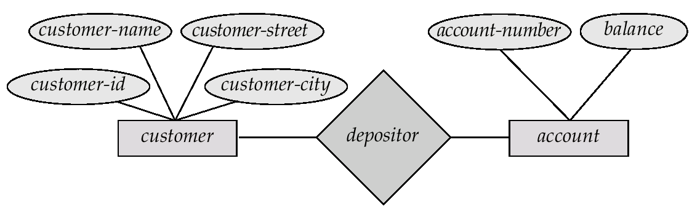
Entity-Relationship Model
Example of schema in the entity-relationship model
Notes:
The entity-relationship (E-R) data model is based on a perception of a real world that
consists of a collection of basic objects, called entities, and of relationships among these
objects. An entity is a “thing” or “object” in the real world that is distinguishable
from other objects. For example, each person is an entity, and bank accounts can be
considered as entities.
Entities are described in a database by a set of attributes.
A relationship is an association among several entities. For example, a depositor
relationship associates a customer with each account that she has. The set of all entities
of the same type and the set of all relationships of the same type are termed an
entity set and relationship set, respectively.
The overall logical structure (schema) of a database can be expressed graphically
by an E-R diagram, which is built up from the following components:

Slide 21
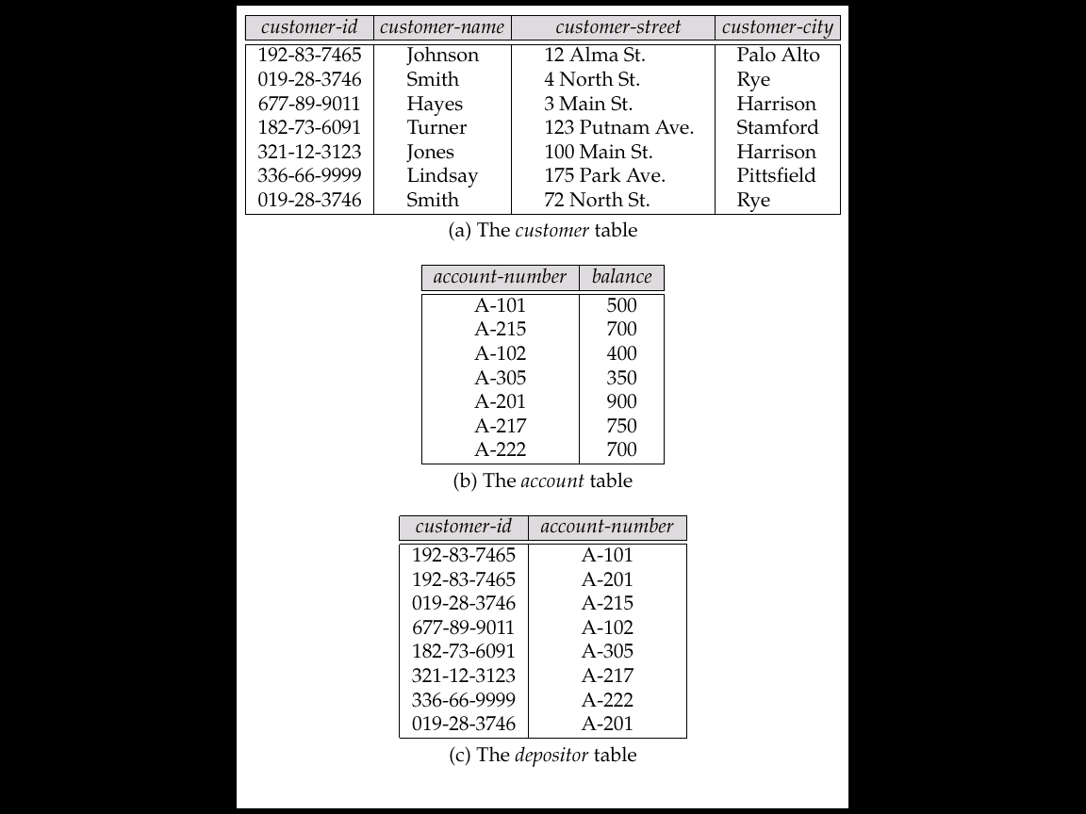
Relational Data Model
A Sample Relational Database
Notes:
The relational model uses a collection of tables to represent both data and the relationships
among those data.

Slide 22
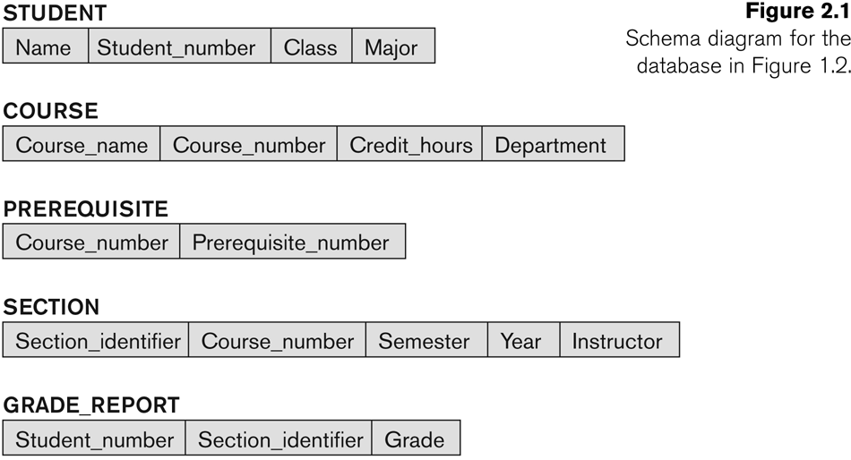
Database Schemas
Database Schema
Description of a database using the given data model
Analogous to type information of a variable in a program
Schema Construct
An object within the schema, e.g., STUDENT, COURSE.

Slide 23
Database State
Database State
Refers to the content of a database at a moment in time.
Also called database instance or occurrence.
Analogous to the value of a variable
Initial State
Database state when it is initially loaded into the system.
Valid State
A state that satisfies the structure and constraints of the database

Slide 24
Example of a database state

Slide 25
Schemas versus State
Schema changes very infrequently, whereas state changes every time the database is updated.
Schema is also called intension, whereas state is called extension.
Database Schema
Database State
Notes:
The distinction between database schema and database state is very important.
When we define a new database, we specify its database schema only to the DBMS.
At this point, the corresponding database state is the empty state with no data.We
get the initial state of the database when the database is first populated or loaded
with the initial data. From then on, every time an update operation is applied to the
database, we get another database state.

Slide 26
Three-Schema Architecture
Proposed to support DBMS characteristics of:
Program data independence
Support multiple views of the data.
Use catalog to store schema
Notes:
Program operation independence

Slide 27
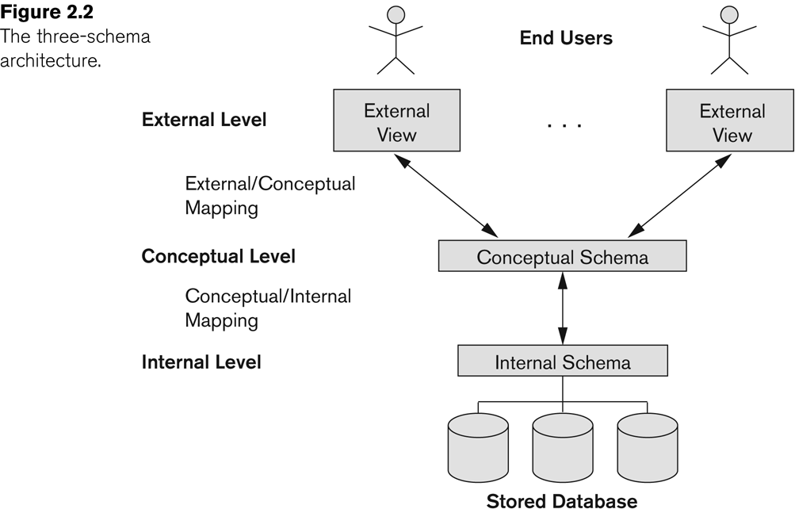
Three-Schema Architecture
Describes the various user views
Describes the structure and constraints for the database
Describes physical storage structures and access paths.
Notes:
The three-schema architecture was proposed to help achieve and visualize the database characteristics described in last slide.
Internal schema Typically uses a physical data model.
The conceptual schema hides the details of physical storage structures and concentrates on describing entities, data types, relationships, user operations, and constraints. Usually, a representational (implementational) or conceptual data model is used to describe the conceptual schema when a database system is implemented.
External schemas, which usually are also in terms of the data model of the DBMS, allow data access to be customized (and authorized) at the level of individual users
or groups of users.
Any given database has exactly one conceptual schema and one physical schema because it has just one set of stored relations, but it may have several
external schemas, each tailored to a particular group of users.
Each external schema consists of a collection of one or more views and relations from the conceptual schema.
A view is conceptually a relation, but the records in a view are not stored in the DBMS. Rather, they are computed using a denition for the view, in terms of relations stored
in the DBMS. The external schema design is guided by end user requirements.
Most DBMSs do not separate the three levels completely and explicitly, but support the three-schema architecture to some extent.
Notice that the three schemas are only descriptions of data; the stored data that actually exists is at the physical level only. In a DBMS based on the three-schema
architecture, each user group refers to its own external schema. Hence, the DBMS must transform a request specified on an external schema into a request against the
conceptual schema, and then into a request on the internal schema for processing over the stored database.
The processes of transforming requests and results between levels are called mappings.

Slide 28
Three-Schema Architecture
Mappings among schema levels are needed to transform requests and data.
Programs refer to an external schema, and are mapped by the DBMS to the internal schema.
Data extracted from the internal DBMS level is reformatted to match the user’s external view
Example: formatting the results of an SQL query for display in a Web page

Slide 29
Data Independence
Physical Data Independence
The capacity to change the internal schema without changing the conceptual schema.
For example: the internal schema may be changed
when certain file structures are reorganized or
new indexes are created to improve database performance
One of the most important benefits of using a DBMS!
Notes:
The three-schema architecture can be used to further explain the concept of data
independence, which can be defined as the capacity to change the schema at one
level of a database system without having to change the schema at the next higher
Level
If the same data as before remains in the database, we should not
have to change the conceptual schema. For example, providing an access
path to improve retrieval speed of section records (Figure 1.2) by semester
and year should not require a query such as list all sections offered in fall 2008
to be changed, although the query would be executed more efficiently by the
DBMS by utilizing the new access path.

Slide 30
Data Independence
Logical Data Independence
The capacity to change the conceptual schema without changing the external schemas and the application programs.
Only the mappings need to be changed in DBMS
It is harder to achieve because it allows structural and constraint changes without affecting application programs
Notes:
The three-schema architecture can be used to further explain the concept of data
independence, which can be defined as the capacity to change the schema at one
level of a database system without having to change the schema at the next higher
Level
We may change the conceptual schema to expand the database (by adding a
record type or data item), to change constraints, or to reduce the database
(by removing a record type or data item). In the last case, external schemas
that refer only to the remaining data should not be affected. For example, the
external schema of Figure 1.5(a) should not be affected by changing the
GRADE_REPORT file (or record type) shown in Figure 1.2 into the one
shown in Figure 1.6(a). Only the view definition and the mappings need to
be changed in a DBMS that supports logical data independence. After the
conceptual schema undergoes a logical reorganization, application programs
that reference the external schema constructs must work as before.
Generally, physical data independence exists in most databases and file environments
where physical details such as the exact location of data on disk, and hardware
details of storage encoding, placement, compression, splitting, merging of
records, and so on are hidden from the user. Applications remain unaware of these
details. On the other hand, logical data independence is harder to achieve because it
allows structural and constraint changes without affecting application programs—a
much stricter requirement.

Slide 31
DBMS Languages
Data Definition Language (DDL)
Data Manipulation Language (DML)
Notes:
The DBMS must provide appropriate languages and interfaces for each category of users.

Slide 32
DBMS Languages
Data Definition Language (DDL):
Used by the DBA and database designers to specify the conceptual schema of a database.
Specification (notation) for defining the database schema. E.g. create table account ( account-number char(10), balance integer)
Storage definition language (SDL) is used to specify internal schema.
View definition language (VDL) is used to define views and their mapping to conceptual schema.
Notes:
DBMSs the DDL is used to define both conceptual and external schemas. In relational
DBMSs, SQL is used in the role of VDL to define user or application views as results
of predefined queries (see Chapters 4 and 5)

Slide 33
DBMS Languages
Data Manipulation Language (DML)
Used to specify database retrievals and updates
Two classes of languages
Procedural (Low Level )
user specifies what data is required and how to get those data
These must be embedded in a programming language
Nonprocedural (High Level )
user specifies what data is required without specifying how to get those data
May be used in a standalone way(query language) or may be embedded in a programming language (host language)
Notes:
Once the database schemas are compiled and the database is populated with data,
users must have some means to manipulate the database. Typical manipulations
include retrieval, insertion, deletion, and modification of the data. The DBMS provides
a set of operations or a language called the data manipulation language
(DML) for these purposes.
In current DBMSs, the preceding types of languages are usually not considered distinct
languages; rather, a comprehensive integrated language is used
Relational Algebra is a procedural Language
A typical example of a comprehensive database language
is the SQL relational database language (see Chapters 4 and 5), which represents
a combination of DDL, VDL, and DML, as well as statements for constraint
specification, schema evolution, and other features

Slide 34
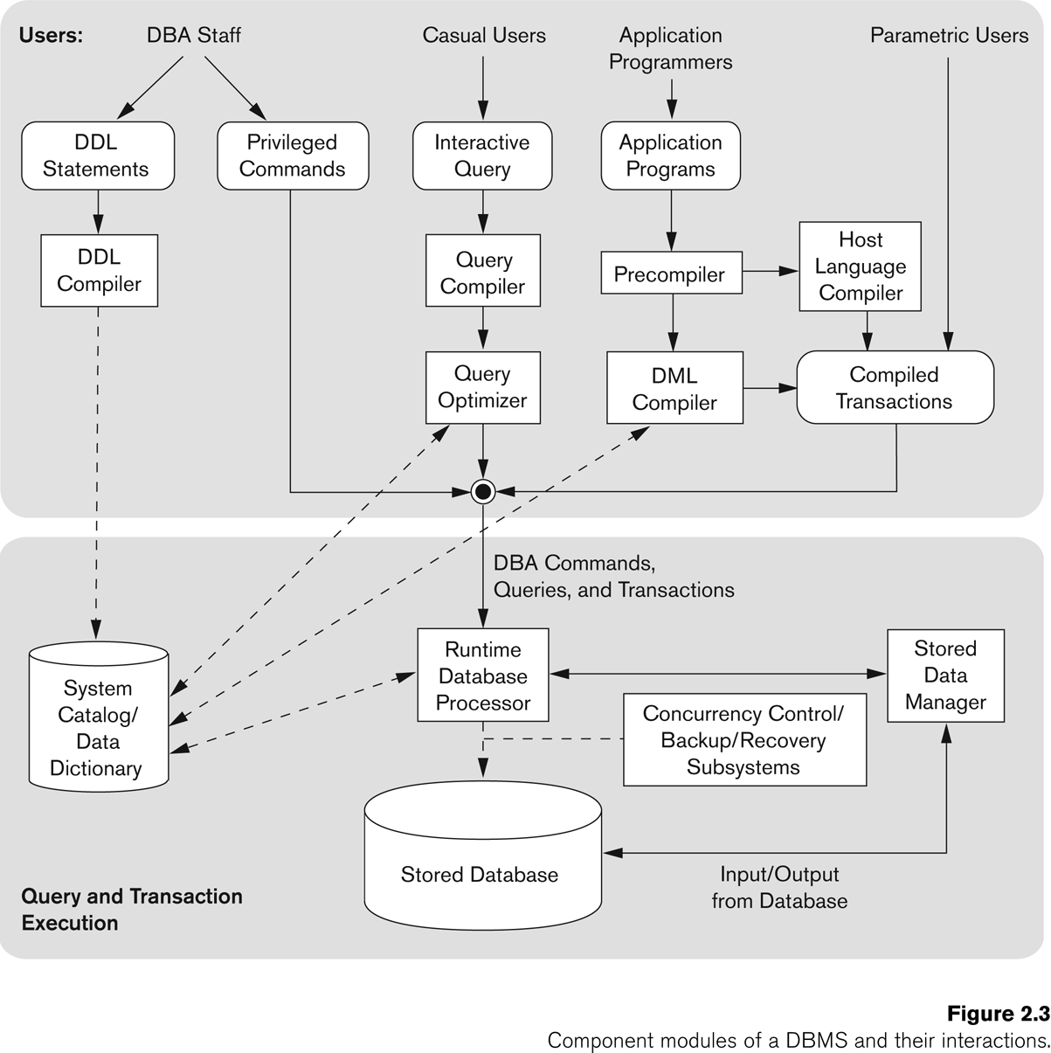
Typical DBMS Component Modules
Notes:
Figure 2.3 illustrates, in a simplified form, the typical DBMS components.
The figure is divided into two parts.
The top part of the figure refers to the various users of the database environment and their interfaces.
The lower part shows the internals of the DBMS responsible for storage of data and processing of transactions.
The database and the DBMS catalog are usually stored on disk. Access to the disk is
controlled primarily by the operating system (OS), which schedules disk
read/write. Many DBMSs have their own buffer management module to schedule
disk read/write, because this has a considerable effect on performance. Reducing
disk read/write improves performance considerably. A higher-level stored data
manager module of the DBMS controls access to DBMS information that is stored
on disk, whether it is part of the database or the catalog.
Let us consider the top part of Figure 2.3 first. It shows interfaces for the DBA staff,
casual users who work with interactive interfaces to formulate queries, application
programmers who create programs using some host programming languages, and
parametric users who do data entry work by supplying parameters to predefined
transactions. The DBA staff works on defining the database and tuning it by making
changes to its definition using the DDL and other privileged commands.
The DDL compiler processes schema definitions, specified in the DDL, and stores
descriptions of the schemas (meta-data) in the DBMS catalog. The catalog includes
information such as the names and sizes of files, names and data types of data items,
storage details of each file, mapping information among schemas, and constraints.
In addition, the catalog stores many other types of information that are needed by
the DBMS modules, which can then look up the catalog information as needed.
Casual users and persons with occasional need for information from the database
interact using some form of interface, which we call the interactive query interface
Among other things, the query optimizer is concerned with the
rearrangement and possible reordering of operations, elimination of redundancies,
and use of correct algorithms and indexes during execution. It consults the system
catalog for statistical and other physical information about the stored data and generates
executable code that performs the necessary operations for the query and
makes calls on the runtime processor.
Application programmers write programs in host languages such as Java, C, or C++
that are submitted to a precompiler. The precompiler extracts DML commands
from an application program written in a host programming language. These commands
are sent to the DML compiler for compilation into object code for database
access. The rest of the program is sent to the host language compiler. The object
codes for the DML commands and the rest of the program are linked, forming a
canned transaction whose executable code includes calls to the runtime database
processor. Canned transactions are executed repeatedly by parametric users, who
simply supply the parameters to the transactions. Each execution is considered to be
a separate transaction. An example is a bank withdrawal transaction where the
account number and the amount may be supplied as parameters.
In the lower part of Figure 2.3, the runtime database processor executes (1) the privileged
commands, (2) the executable query plans, and (3) the canned transactions
with runtime parameters. It works with the system catalog and may update it with
statistics. It also works with the stored data manager, which in turn uses basic operating
system services for carrying out low-level input/output (read/write) operations
between the disk and main memory. The runtime database processor handles other
aspects of data transfer, such as management of buffers in the main memory. Some
DBMSs have their own buffer management module while others depend on the OS
for buffer management.We have shown concurrency control and backup and recovery
systems separately as a module in this figure. They are integrated into the working
of the runtime database processor for purposes of transaction management.
Figure 2.3 is not meant to describe a specific DBMS; rather, it illustrates typical
DBMS modules. The DBMS interacts with the operating system when disk
accesses—to the database or to the catalog—are needed. If the computer system is
shared by many users, the OS will schedule DBMS disk access requests and DBMS
processing along with other processes. On the other hand, if the computer system is
mainly dedicated to running the database server, the DBMS will control main memory
buffering of disk pages. The DBMS also interfaces with compilers for generalpurpose
host programming languages, and with application servers and client
programs running on separate machines through the system network interface.

Slide 35
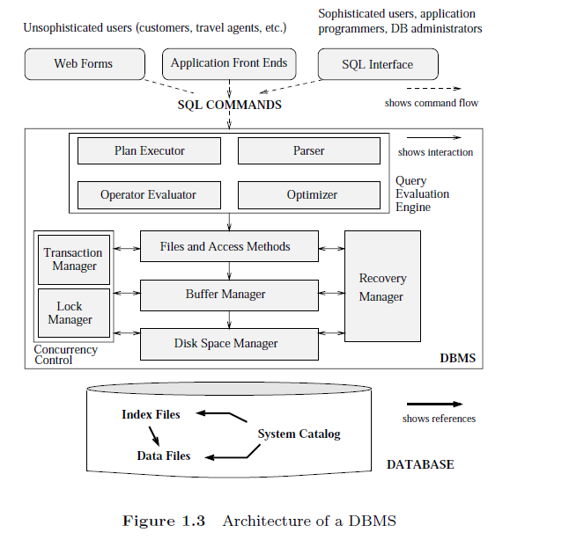
Notes:
Figure 1.3 shows the structure (with some simplication) of a typical DBMS based on the relational data model.

Slide 36
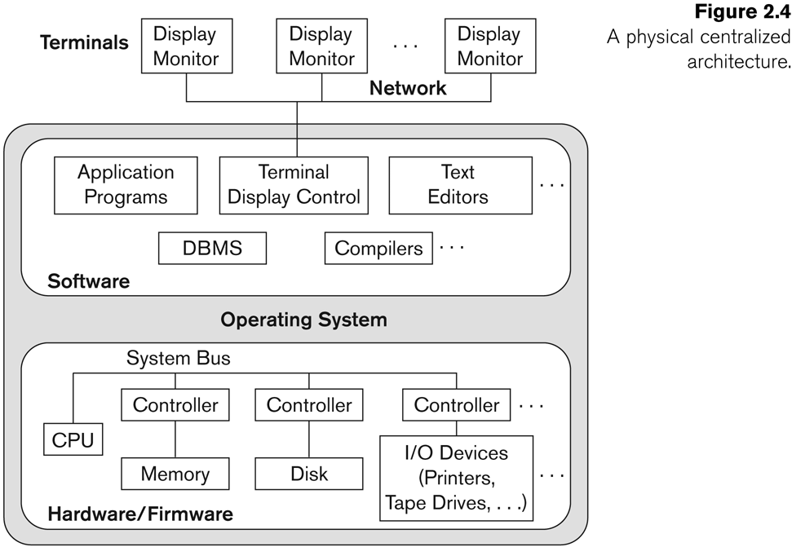
DBMS Architectures
Centralized DBMS
Combines everything into single system: DBMS software, hardware, application programs, and user interface .
User can connect through a remote terminal.
Notes:
Earlier architectures used mainframe computers to provide
the main processing for all system functions, including user application programs
and user interface programs, as well as all the DBMS functionality. The reason was
that most users accessed such systems via computer terminals that did not have processing
power and only provided display capabilities. Therefore, all processing was
performed remotely on the computer system, and only display information and
controls were sent from the computer to the display terminals, which were connected
to the central computer via various types of communications networks.
As prices of hardware declined, most users replaced their terminals with PCs and
workstations. At first, database systems used these computers similarly to how they
had used display terminals, so that the DBMS itself was still a centralized DBMS in
which all the DBMS functionality, application program execution, and user interface
processing were carried out on one machine. Figure 2.4 illustrates the physical
components in a centralized architecture. Gradually, DBMS systems started to
exploit the available processing power at the user side, which led to client/server
DBMS architectures.

Slide 37
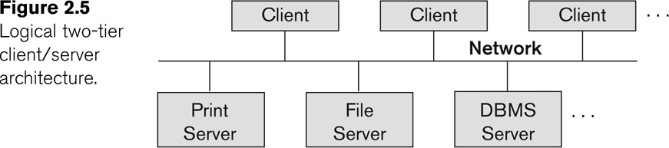
Basic 2-tier Client-Server Architectures
Client
a user machine with user interface capabilities and local processing.
It can access the specialized servers as needed
Server
contains both hardware and software that provide services to clients, such as printing, file access, or database access
Notes:
First, we discuss client/server architecture in general, then we see how it is applied to
DBMSs. The client/server architecture was developed to deal with computing environments
in which a large number of PCs, workstations, file servers, printers, data base servers, Web servers, e-mail servers, and other software and equipment are
connected via a network. The idea is to define specialized servers with specific
functionalities. For example, it is possible to connect a number of PCs or small
workstations as clients to a file server that maintains the files of the client machines.
Another machine can be designated as a printer server by being connected to various
printers; all print requests by the clients are forwarded to this machine. Web
Servers or e-mail servers also fall into the specialized server category.
In (RDBMSs), many of which started as centralized systems, the system components that were first moved to the client side
were the user interface and application programs. Because SQL provided a standard language for RDBMSs, this created a logical dividing point
between client and server. Hence, the query and transaction functionality related to
SQL processing remained on the server side. In such an architecture, the server is
often called a query server or transaction server because it provides these two
functionalities. In an RDBMS, the server is also often called an SQL server.

Slide 38
DBMS Server
Provides database query and transaction services to the clients
Relational DBMS servers are often called SQL servers, query servers, or transaction servers
Applications running on clients utilize an Application Program Interface (API) to access server databases via standard interface such as:
ODBC: Open Database Connectivity standard
JDBC: for Java programming access
Notes:
The user interface programs and application programs can run on the client side.
When DBMS access is required, the program establishes a connection to the DBMS
(which is on the server side); once the connection is created, the client program can
communicate with the DBMS. A standard called Open Database Connectivity
(ODBC) provides an application programming interface (API), which allows
client-side programs to call the DBMS, as long as both client and server machines
have the necessary software installed. Most DBMS vendors provide ODBC drivers
for their systems. A client program can actually connect to several RDBMSs and
send query and transaction requests using the ODBC API, which are then processed
at the server sites. Any query results are sent back to the client program, which can
process and display the results as needed. A related standard for the Java programming
language, called JDBC, has also been defined. This allows Java client programs
to access one or more DBMSs through a standard interface.

Slide 39
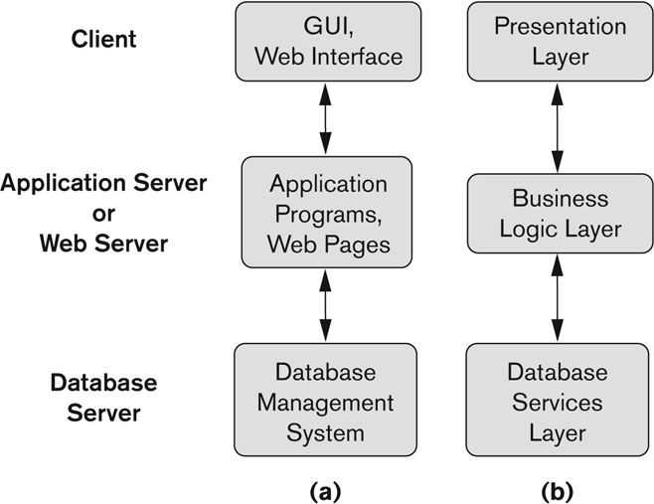
Three Tier Client-Server Architecture
Adds Intermediate layer called Application Server or Web Server.
Middle Tier stores business logic that is use to access data from the database server
Enhance security as DB server is only accessible via middle tier
Notes:
This intermediate layer or middle tier is called the application server or the Web
server, depending on the application. This server plays an intermediary role by running
application programs and storing business rules (procedures or constraints)
that are used to access data from the database server.
It can also improve database security by checking a client’s credentials before forwarding a request to the database
server. Clients contain GUI interfaces and some additional application-specific
business rules. The intermediate server accepts requests from the client, processes
the request and sends database queries and commands to the database server, and
then acts as a conduit for passing (partially) processed data from the database server
to the clients, where it may be processed further and filtered to be presented to users
in GUI format.
Thus, the user interface, application rules, and data access act as the
three tiers. Figure 2.7(b) shows another architecture used by database and other
application package vendors.
The presentation layer displays information to the user and allows data entry.
The business logic layer handles intermediate rules and constraints before data is passed up to the user or down to the DBMS.
The bottom layer includes all data management services.
The middle layer can also act as a Web server, which retrieves query results from the database server and formats them into
dynamic Web pages that are viewed by the Web browser at the client side.

Slide 40
Classification of DBMSs
Based on the data model used
Traditional: Relational, Network, Hierarchical.
Emerging: Object-oriented, Object-relational.
Single-user (typically used with personal computers) vs. multi-user (most DBMSs).
Centralized (single computer) vs. distributed (multiple computers, multiple databases)
Notes:
The third criterion is the number of sites over which the database is distributed. A
DBMS is centralized if the data is stored at a single computer site. A centralized
DBMS can support multiple users, but the DBMS and the database reside totally at
a single computer site. A distributed DBMS (DDBMS) can have the actual database
and DBMS software distributed over many sites, connected by a computer network.
Homogeneous DDBMSs use the same DBMS software at all the sites, whereas
heterogeneous DDBMSs can use different DBMS software at each site. It is also
possible to develop middleware software to access several autonomous preexisting
databases stored under heterogeneousDBMSs. This leads to a federated DBMS (or
multidatabase system), in which the participating DBMSs are loosely coupled and
have a degree of local autonomy. Many DDBMSs use client-server architecture, as
we described in Section 2.5.

Slide 41
Distributed DBMSs (DDBMSs)
Distributed Database Systems can have database and DBMS software distributed over many sites
Homogeneous DDBMS
Heterogeneous DDBMS
Uses client-server architecture
Notes:
A distributed DBMS (DDBMS) can have the actual database
and DBMS software distributed over many sites, connected by a computer network.
Homogeneous DDBMSs use the same DBMS software at all the sites, whereas
heterogeneous DDBMSs can use different DBMS software at each site. It is also
possible to develop middleware software to access several autonomous preexisting
databases stored under heterogeneousDBMSs. This leads to a federated DBMS (or
multidatabase system), in which the participating DBMSs are loosely coupled and
have a degree of local autonomy. Many DDBMSs use client-server architecture, as
we described in Section 2.5.

Slide 42
Record-based Logical Models
Describe data at the conceptual and view levels.
Provide a higher-level description of the implementation.
The database is structured in fixed-format records of several types.
Each record defines a fixed number of fields, or attributes.
Each field is usually of a fixed length (this simplifies the implementation).
The three most widely-accepted models are
relational,
network, and
hierarchical.
Notes:
Specify overall logical structure of the database

Slide 43
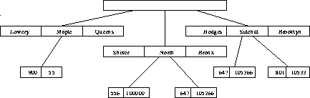
Hierarchical Model
Organization of the records is as a collection of trees
A child can have only one parent, but a parent can have many children.
Drawback- Data redundancy
Cannot handle many-to-many relationship
Example: employee with many supervisors
Notes:
a major drawback
is data redundancy. This problem occurs because the hierarchical model handles the one-to-many
relationship very well, but is unable to deal with a many-to-many relationship, causing
data to be duplicated. For example, a hierarchical chart showing an employee who reports to
more than one supervisor would require duplicating that employee’s information.

Slide 44
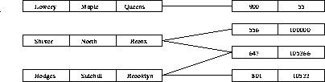
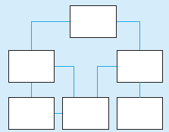
Network Model
Data are represented by collections of records.
Relationships among data are represented by links.
Organization is that of an arbitrary graph.
Eliminates hierarchical model problem issue
Allow many to many relationship
Limitations: difficult to query data from multiple tables and issues in indexing scheme

Slide 45
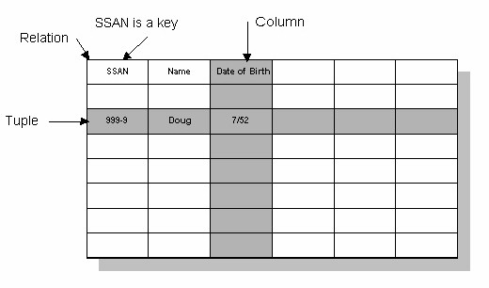

Relational Model
Data and relationships are represented by a set of tables.
A tuple or row contains all the data of a single instance of the table.
Each table has a number of columns with unique names
Every row must have a unique ID or key based on the data.

Slide 46
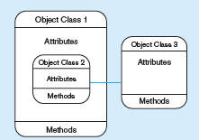
Object Data Model
Defines database in terms of objects, their properties and operations.
Objects with same structure and behavior belong to a class
Classes are organized into hierarchies
The operations of each class are specified as methods
Describe data at the conceptual and view levels.
Notes:
Allow one to specify data constraints explicitly.
Internal parts of the object, the instance variables and method code, are not visible externally.

Slide 47
DBMS Interfaces
Stand-alone query language interfaces
Example: Entering SQL queries at the DBMS interactive SQL interface (e.g. SQL*Plus in ORACLE)
Programmer interfaces for embedding DML in programming languages
User-friendly interfaces such as
Menu-based, forms-based, graphics-based, etc.

Slide 48
Database System Utilities
To perform certain functions such as:
Loading data stored in existing files into a database. includes data conversion tools.
Backing up the database periodically on tape.
Reorganizing database file structures.
Report generation utilities.
Performance monitoring utilities.
Other functions, such as sorting, user monitoring, data compression, etc.

